Slide 1
NETFLIX
GROUP 6

Slide 2



Group 6
Sravitha Matlapudi
Stefanie Ganon
Khanh Le

Slide 3

Agenda
Importing Libraries
Loading the Dataset
Data Overview
Data Cleaning
Exploratory Data Analysis and Visualization
Conclusions

Slide 4
Netflix
Netflix is one of the most popular digital streaming media service providers today.
Netflix provides streaming services for movies and tv shows from various countries in the world.

Slide 5
Data Analysis Process
Step 1
Importing Datasets
Step 2
Loading Datasets
Step 3
Data Overview
Step 4
Data Cleaning
Step 5
Exploratory Data Analysis and Visualization
Step 6
Conclusion

Slide 6
Importing Libraries

Slide 7
Libraries
Pandas
Opendatasets
Os
Csv
Matplotlib. Pylot
Numpy
Notes:
(These don’t have designer IDs since they were based off the default master slides already in the deck.

Slide 8
Loading datasets

Slide 9
Data overview

Slide 10
Data cleaning

Slide 11
Data analysis & visualization

Slide 12
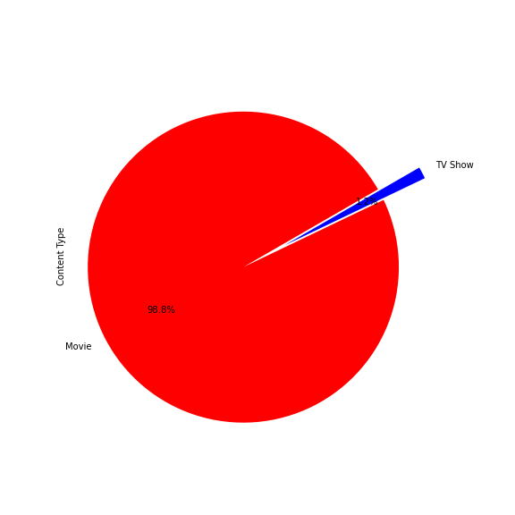
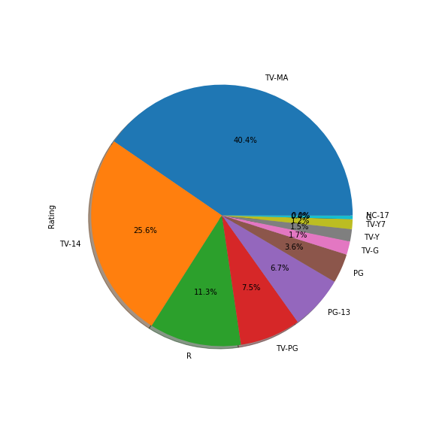
Percentages of
Content types
Rating types

Slide 13
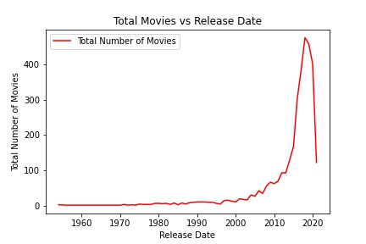
Numbers of movies per year

Slide 14
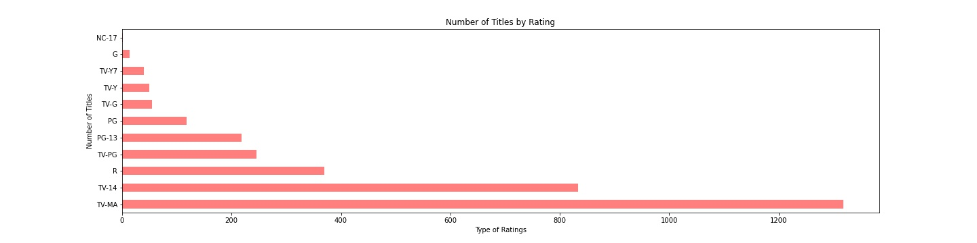
Number of content by rating

Slide 15
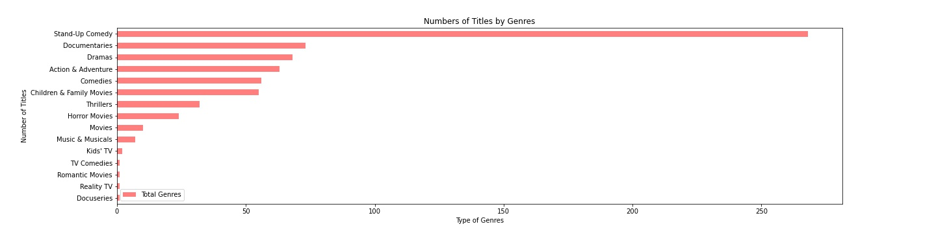
Top Genres with the largest number of titles

Slide 16
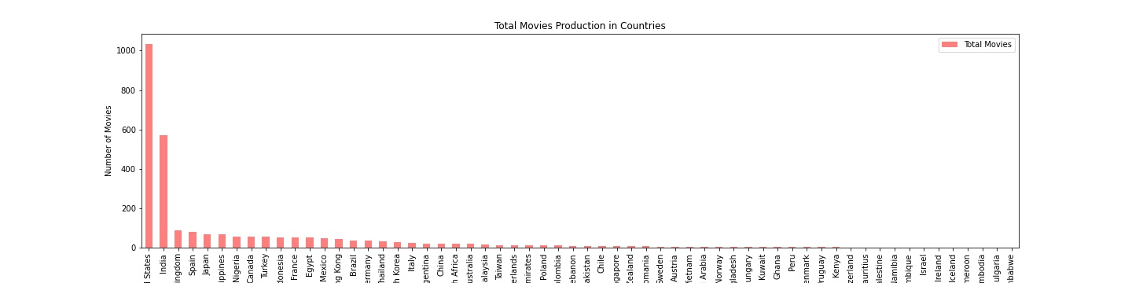
Top producing countries

Slide 17
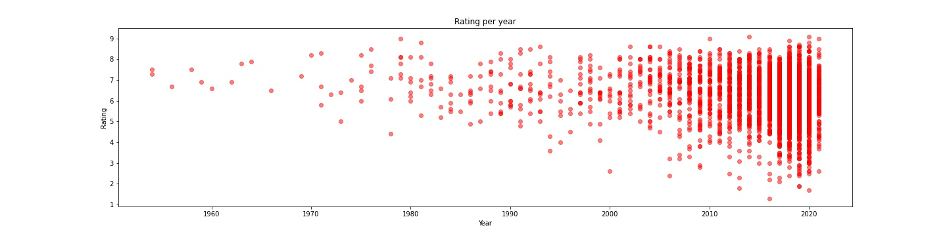
Ratings per year

Slide 18
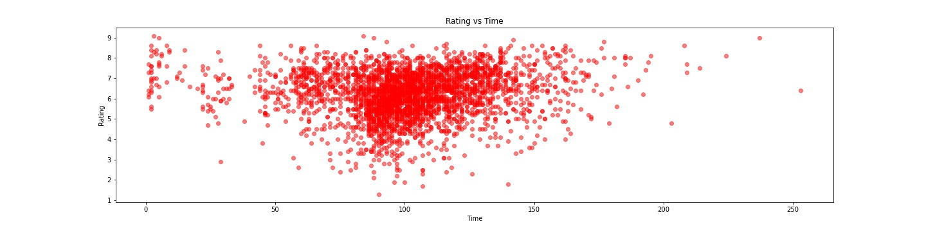
Ratings vs Run time

Slide 19
Findings

Slide 20
Conclusions

Slide 22
Thank you

